Slide 1
Cutting Edge Adv Vocab Builder Mod 2

Slide 2
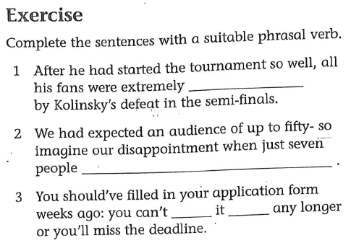
let down
turned up
put
off

Slide 3
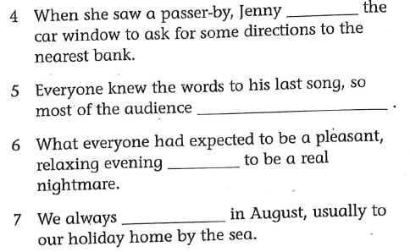
rolled down
sang along
turned out
go away for a while

Slide 4
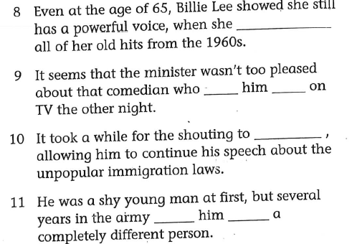
belted out
sent
up
die down
turn
into

Slide 5
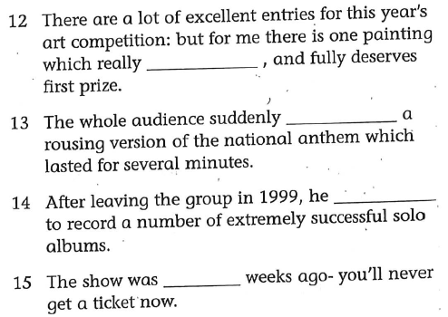
stood out
launched into
went on
sold out

Slide 6
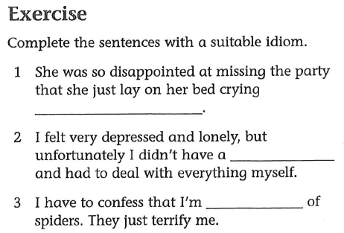
her eyes out
shoulder to cry on
scared stiff

Slide 7
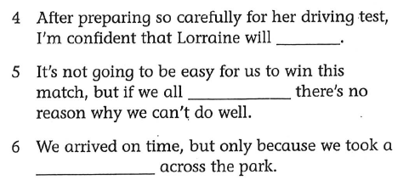
pass with flying colours
give (it) one hundred percent
short cut

Slide 8
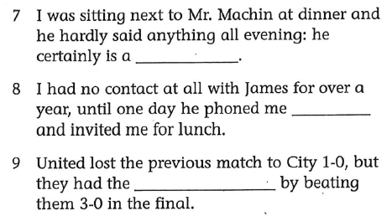
man of few words
out of the blue
last laugh

Slide 9
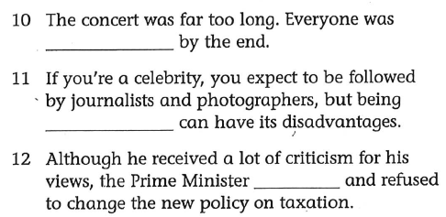
bored to tears
in the public eye
stood firm

Slide 10
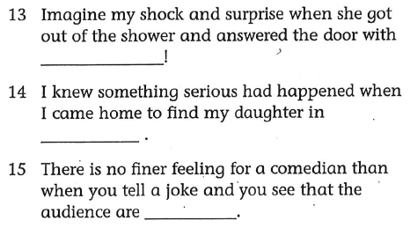
with not a stitch on/ without a stitch on
floods of tears
laughing their heads off

Slide 11
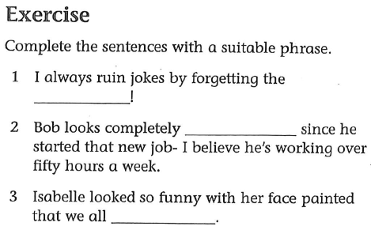
punch line
stressed out
bursed out laughing

Slide 12
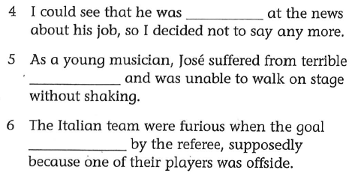
close to tears
stage-fright
was disallowed

Slide 13
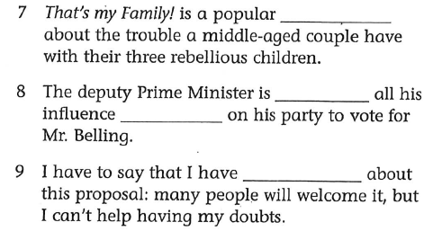
sit-com
bringing
to bear
mixed feelings

Slide 14
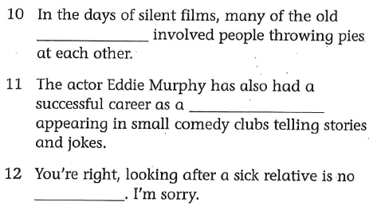
slapstick comedy
stand-up comedian
laughing matter

Slide 15
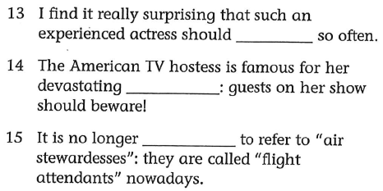
suffer from stage fright
put-downs
politically correct

Slide 16
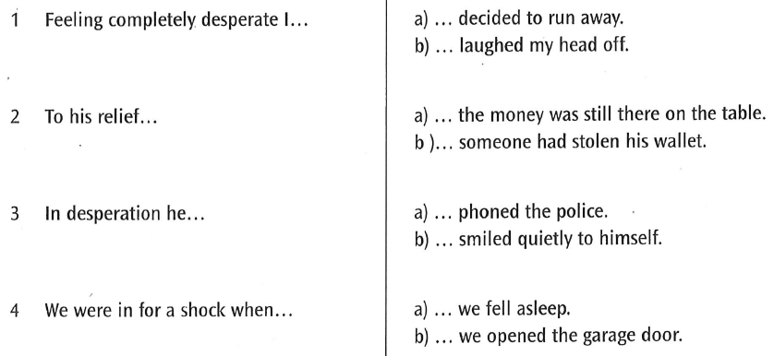

Slide 17
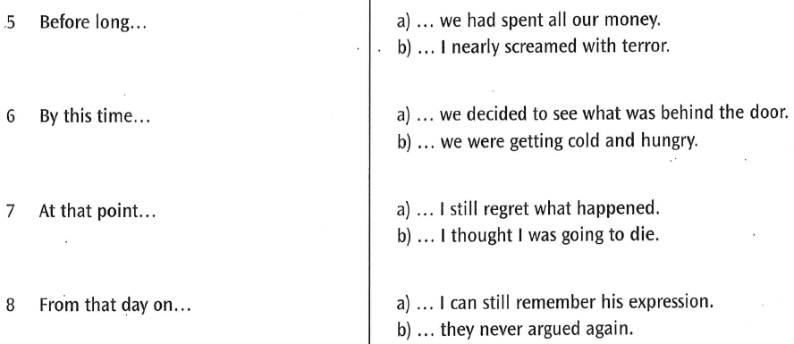

Slide 18
